Slide 1
State of Nevada DIVISION OF INDUSTRIAL RELATIONS WORKERS’ COMPENSATION SECTION
CARDS 301B: Electronic D-35 for Insurers and TPAs
(Claims and Regulatory Data System)

Slide 2
Overview
Objectives
At the completion of this course, training participants will be able to submit the D-35 webform and understand the Permanent Partial Disability (PPD) Rating Request process.

Slide 3
INSURER/TPA OR INJURED WORKER/REP SUBMITS A REQUEST FOR RATER USING THE D-35 WEBFORM TO WCS
WCS PROCESS THE D-35 AND ASSIGNS THE PPD RATING TO A RATER
RATER ACCEPTS OR DECLINES THE ASSIGNMENT
IF ACCEPTED, RATER PERFORMS PPD EVALUATION
The claim needs to be “Indexed” first in our CARDS system before a Request for a Rater is processed by WCS.
Notes:
The new D-35 Webform submission process is scheduled to begin Monday, June 2, 2025.
Note: Technically the D-35 process ends when the rater accepts the assignment.

Slide 4
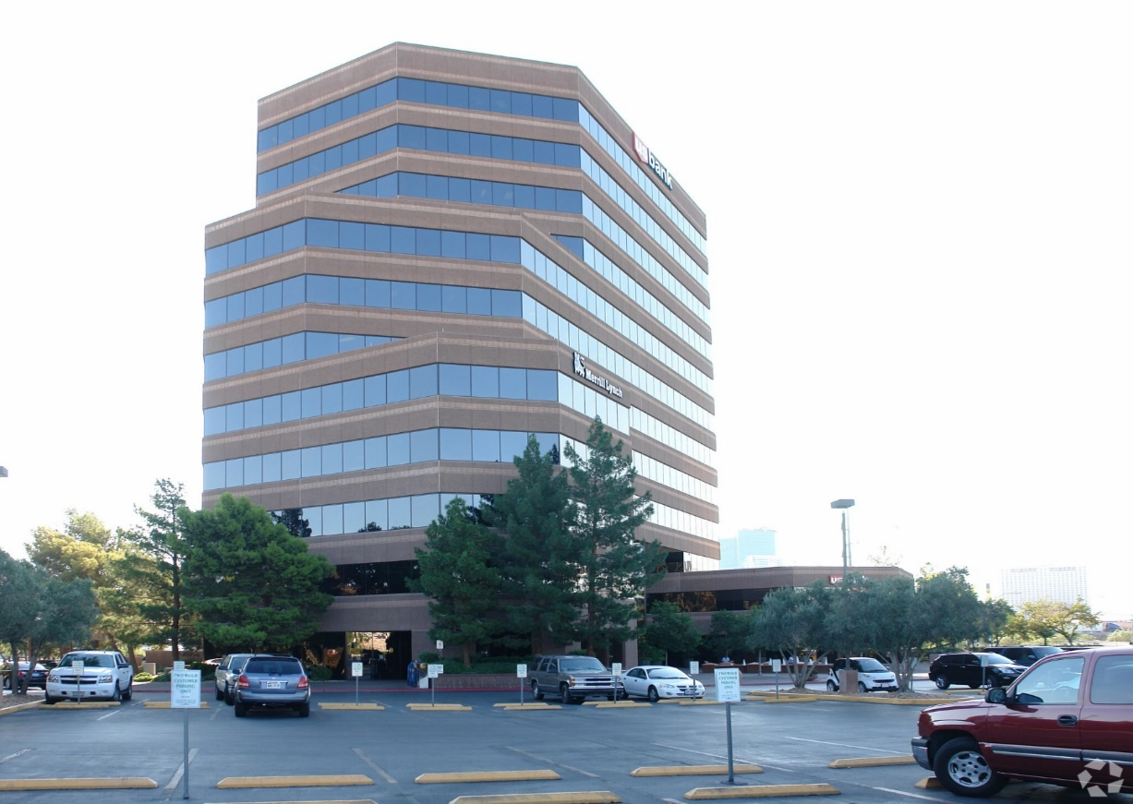
FILING A D-35 WEBFORM
FILING A D-35 REQUEST FOR AUTHENTICATED USERS

Slide 5
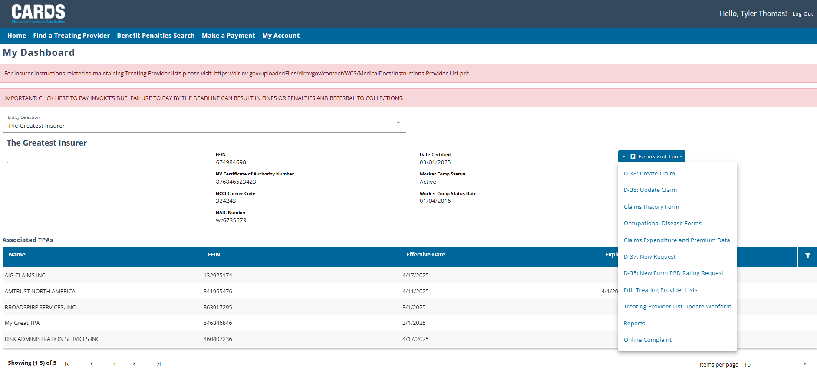
INSURER/TPA CARDS HOMEPAGE
FILING A D-35 REQUEST FOR AUTHENTICATED USERS
Insurer and TPA’s Forms and Tools may have different look depending on the type of Access they have.
Notes:
Select D-35 from the Forms and Tools Dropdown Menu.
The D-35 is the official request for assignment/scheduling of PPD evaluation to determine the IW’s Permanent Partial Impairment rating.

Slide 6
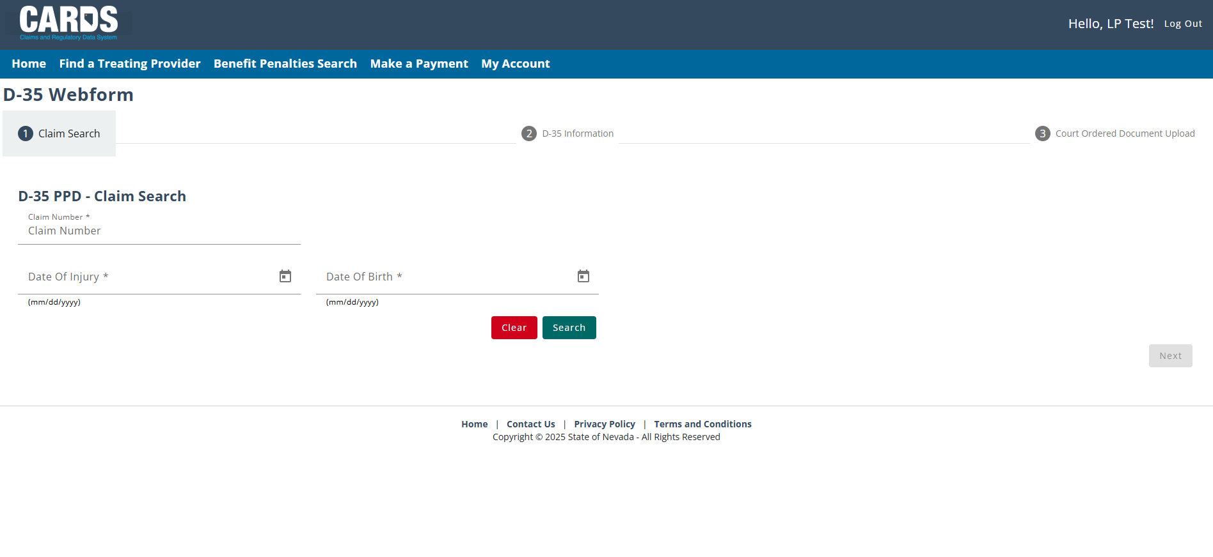
FILING A D-35 WEBFORM
PART 1 : CLAIM SEARCH
Fill out the information needed then hit Search.
Notes:
All three fields are required to search for the claim.

Slide 7
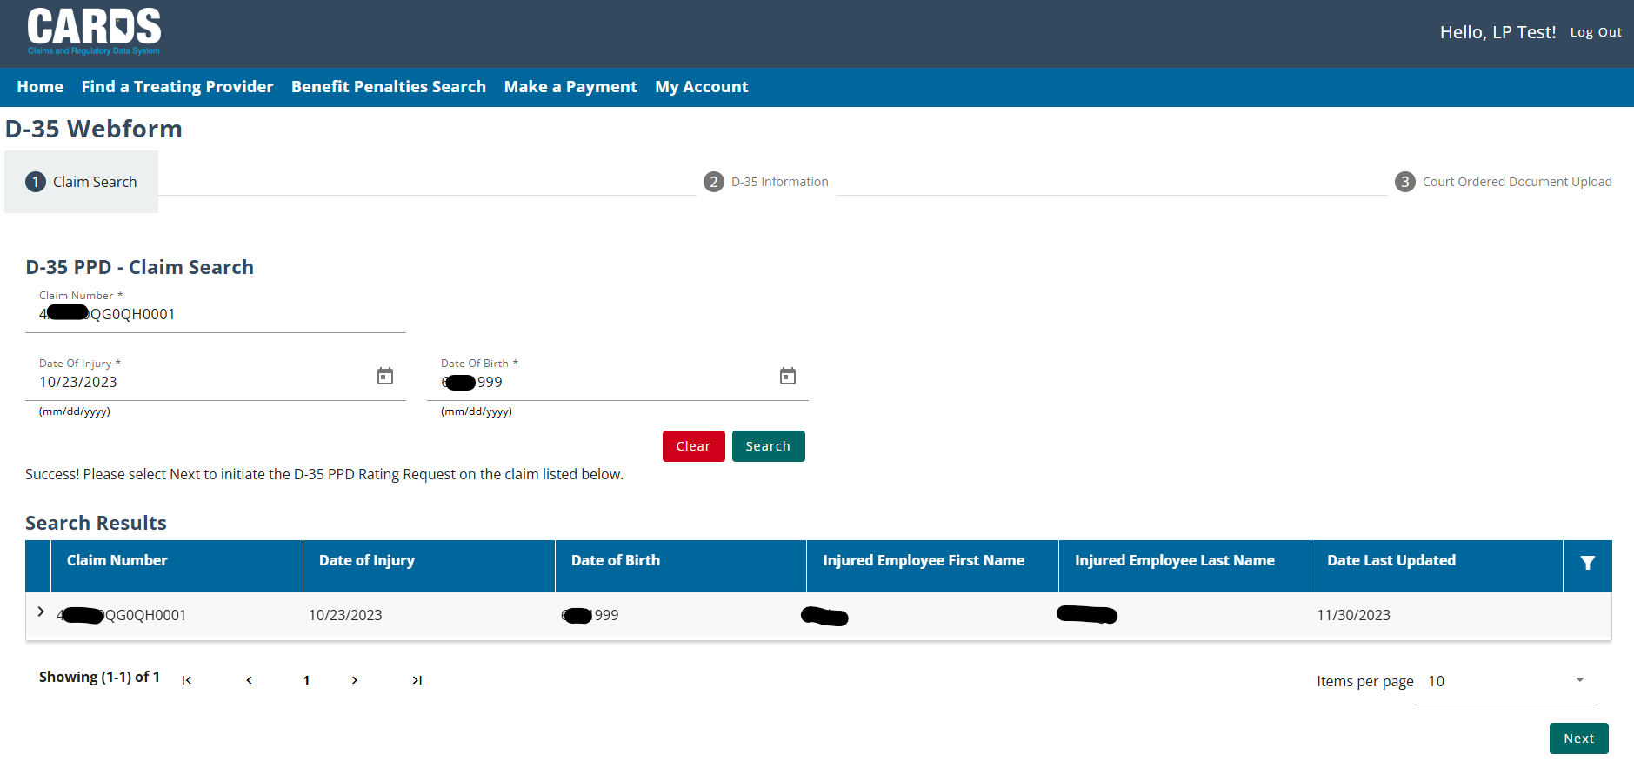
FILING A D-35 WEBFORM
FILING A D-35 REQUEST FOR AUTHENTICATED USERS
Once you found the claim, hit Next.
Notes:
If no results are found, re-check your entries for the claim#, DOI, and DOB. (All three components are required to match the claim information.)

Slide 8
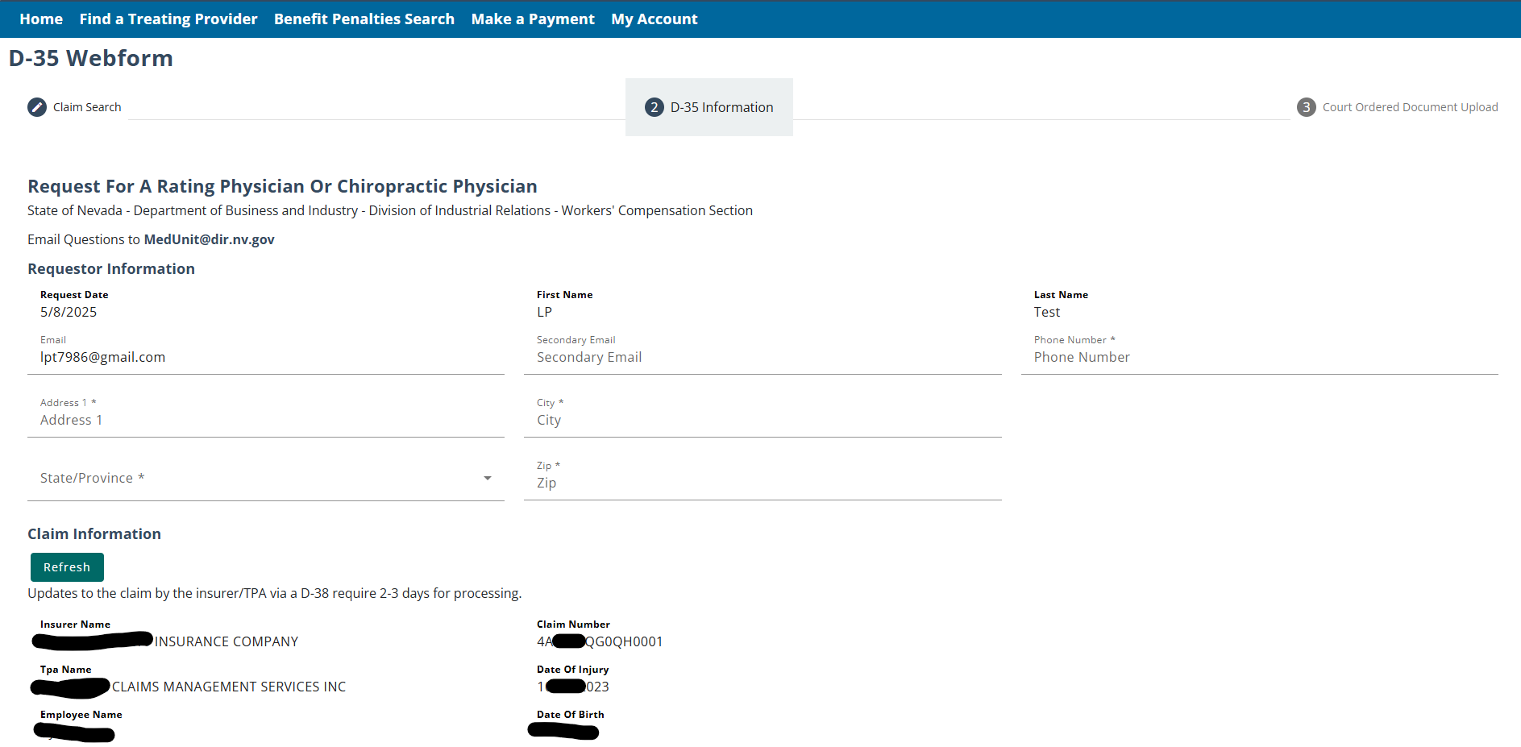
FILING A D-35 WEBFORM
PART 2 : D-35 INFORMATION
Notes:
Complete the required fields, some information populates from the account information and the claim information.

Slide 9
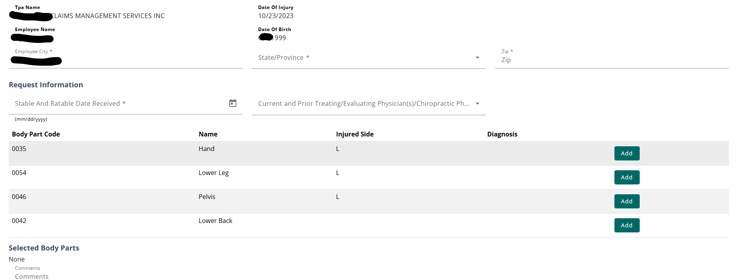
FILING A D-35 WEBFORM
PART 2 : D-35 INFORMATION – BODY PARTS
The body parts that can be selected on the webform must come from an approved claim and must be accepted on the claim. Select the body part and add the diagnosis for each body part selected.
Notes:
You must complete:
The Stable and Ratable date, which must be after the date of injury (DOI) but prior to the date of D-35 Webform submission.
The BPC, Name/Body Part, and Injured side are populated from the indexed claim information.
The submitter must add the diagnosis for each body part by clicking on the green “Add” button and completing the require field(s).

Slide 10
FILING A D-35 WEBFORM
PART 2 : D-35 INFORMATION – COURT ORDERED
If the PPD rating request has been court ordered, it must be indicated on the D-35. In part 3 of the form, the user will be able to submit any documentation pertaining to the court order. In the case of a court ordered request, you will have the ability to select a rating physician from the available raters if they had been selected from the court order.
Notes:
Part 2
Court Order (Mutual Agreement and Previous PPD indicators are located in this area as well.)
Part 3 Submit CO documents – search computer or drag and drop.

Slide 11
FILING A D-35 WEBFORM
PART 2 : D-35 INFORMATION – COURT ORDERED DOCUMENT UPLOAD
If the requestor has indicated that the PPD request is court ordered, they must upload all relevant documentation before submitting the D-35 webform. For PPD requests that are not court ordered, requestors will be able to submit after Part 2.

Slide 12
FILING A D-35 WEBFORM
PART 2 : D-35 INFORMATION – MUTUAL AGREEMENT
If a user has a mutual agreement with a rating physician that is willing to conduct the PPD rating requested, they can select the middle check box at the bottom of the form and fill out the information about the agreement. The rating physician must be selected in the case of a Mutual agreement, and additional fields will populate based on the selection.
Notes:
Mutual Agreement:
Complete required fields and select rating physician’s name from the dropdown.

Slide 13
FILING A D-35 WEBFORM
PART 2 : D-35 INFORMATION – PREVIOUS PPD EVALUATION
If this is not the first PPD evaluation process that has been initiated on the selected claim, the name of the rating physician and the reason for a new request must be provided. A rater can not be assigned to a request if they had conducted a previous PPD rating, unless the rating is related to a body part that has not previously been rated.

Slide 14
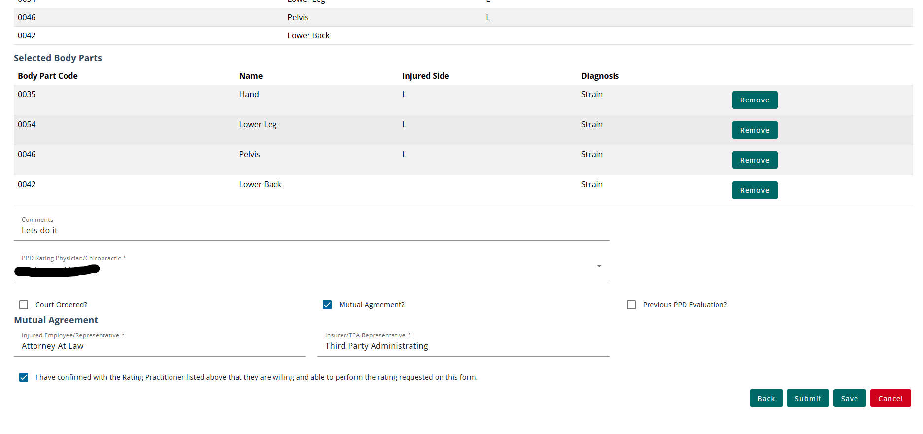
FILING A D-35 WEBFORM
FILING A D-35 REQUEST FOR AUTHENTICATED USERS
After all the required fields have been filled in, users can submit the webform. After pressing the submit button, a modal will pop up to confirm the submission. After pressing submit in the modal, users will be taken back to the dashboard and shown a success message. The submission can be viewed on the Filing History tab.
Notes:
Review for accuracy prior to submitting the form.

Slide 15
FILING A D-35 WEBFORM
CORRECTING THE D-35 WEBFORM
If the Med Unit finds any errors in a D-35 submission, they can send the webform back to the requestor for corrections. If your D-35 submission needs corrections, you will receive an email notification with instructions when it needs to be updated. Note: This may mean that there is information that you need to go back and update on the original claim (D-38) form as well.
The webforms that require corrections can be found in the Filing History tab and will show the “Corrections Required” status. The form can be opened from the link in the Submission Type column to correct any necessary information.
Notes:
Filing history status changes to: Corrections required if MU staff find errors while review the form.
Submission Type column items that are bold = active link.

Slide 16
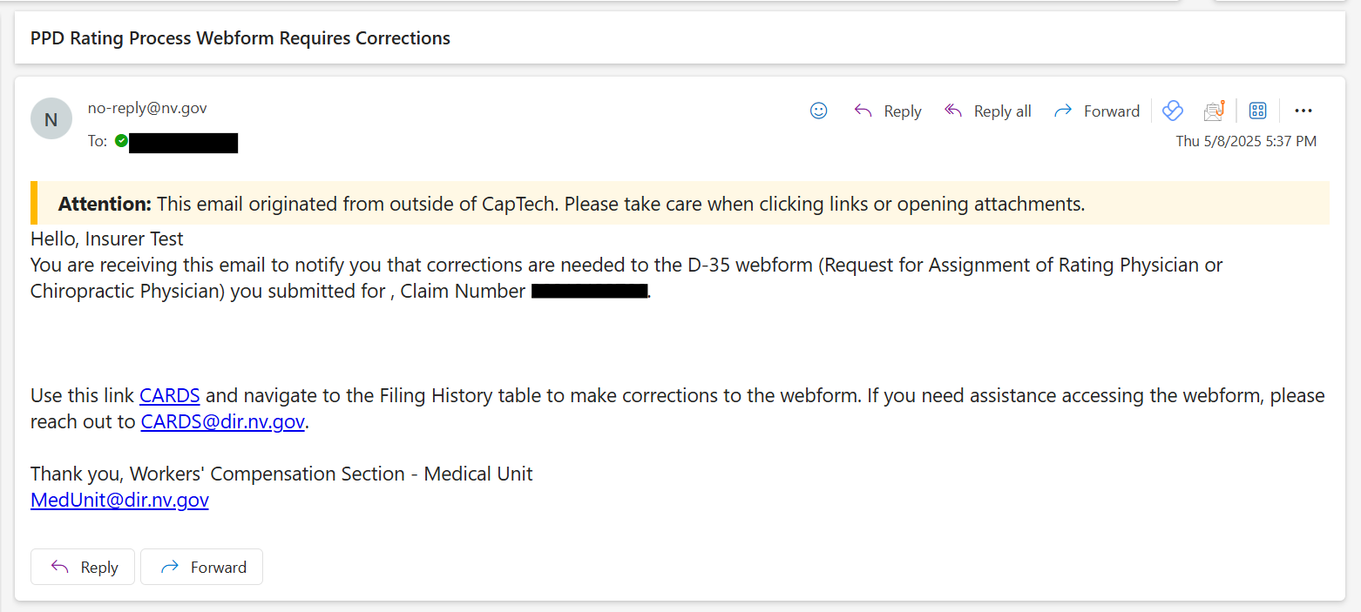
FILING A D-35 WEBFORM
D-35 CORRECTIONS REQUIRED EMAIL NOTIFICATION
The correction notification email will include a link for you navigate into CARDS to view the corrections needed to the D-35 webform.
Notes:
Subject line: PPD Rating Process Webform Requires Corrections
Email notice is sent to the submitter.

Slide 17
FILING A D-35 WEBFORM
ACCEPTED D-35 WEBFORM
Once the webform has been accepted by the internal Med Unit, the status of the webform will update to “Accepted” and the generated PPD Rating Request will populate in the PPD Rating Tab. At this point, the rating physician has been assigned.
Notes:
Once Accepted, the Filing History tab, status column will update to reflect “accepted.
The processed rating request will now be populated on the PPD Rating Request Tab

Slide 18
KNOWLEDGE CHECK

Slide 19
RATING ASSIGNMENT

Slide 20
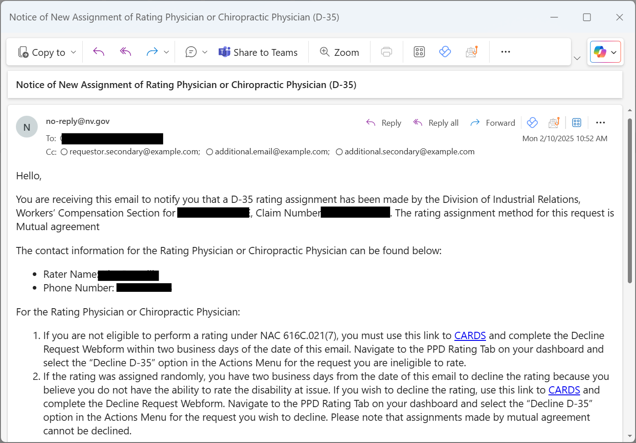
RATING ASSIGNMENT
When an assignment has occurred on the request, the submitter of the form and the assigned physician will be notified via email of the assignment. The contact information of the physician will be provided in the email. The email will include a PDF version of the submitted data from CARDS in the template shown below.

Slide 21
PPD RATING REQUEST STATUS
When an assignment has occurred on the request, request will remain in the “Pending” status until the physician choses to either decline a request, mark themselves as ineligible to perform the request, or two days have elapsed since the assignment. Once the two days have elapsed, the request will be accepted, and the rating appointment can be completed

Slide 22
DECLINED/ INELIGIBLE REQUESTS
If the assigned rating physician chooses to decline a request or mark them as ineligible to perform the rating, the status of the request will update to reflect the action taken. You will have the ability to update the rating for a new assignment or a random assignment will occur automatically after 6 days.

Slide 23
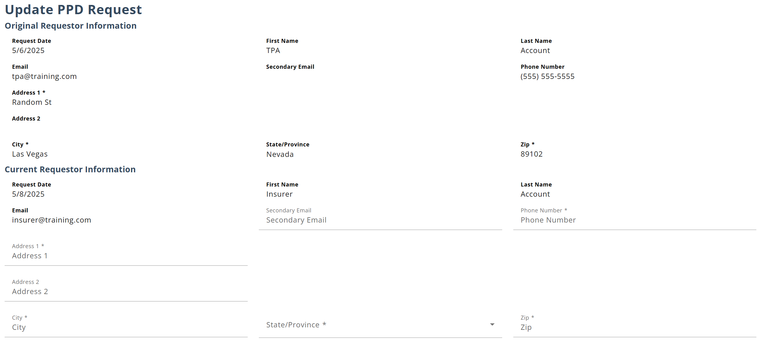
DECLINED/ INELIGIBLE REQUESTS
Once a request has been declined, you are able to reopen the D-35 webform to submit updates. Updates can also be made prior to the acceptance of the request from the physician if there are any changes to the request.

Slide 24
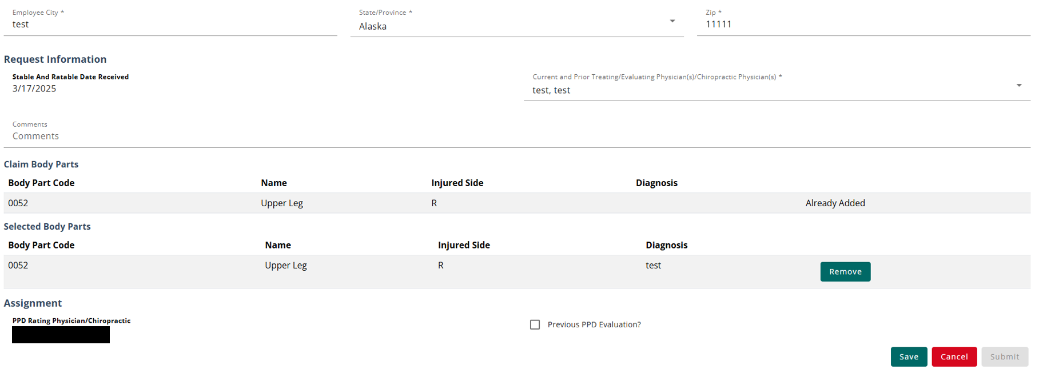
UPDATED D-3 WEBFORM
The update form only allows certain details to be updated, such as the injured employee information and updates to the selected body parts. The rating physician can only be updated if the rater declined the request or marked themselves as ineligible. If a general update is made, the rater will remain on the request.

Slide 25
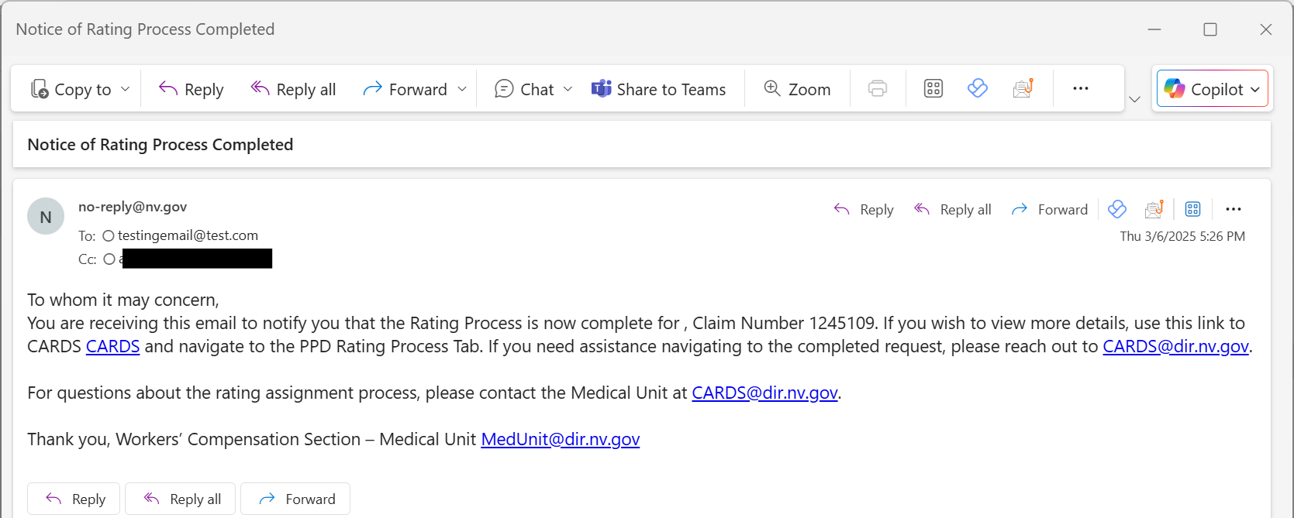
COMPLETING THE RATING PROCESS
The rating process is complete once the rating has been submitted. An email will be sent to all involved parties including the requestor, the clinical practitioner, and any additional emails provided in the PPD transaction.

Slide 26
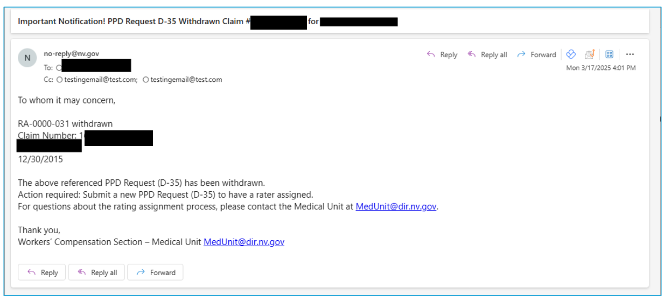
WITHDRAWN REQUESTS
When a request is withdrawn, an email will be sent to all involved parties including the requestor, the clinical practitioner, and any additional emails provided in the PPD transaction. No additional action can be taken once a request is withdrawn.

Slide 27
COMPLAINT WEBFORM
FILING A COMPLAINT FOR NON-AUTHENTICATED USERS

Slide 28
COMPLAINT WEBFORM
FILING A COMPLAINT IN CARDS FOR NON-AUTHENTICATED USERS
One of the new features of CARDS is the ability to file an online complaint. The form will gather basic information about the complainant and the details of the complaint, as well as asking a series of questions to determine the nature of the compliant. Once the complaint form is submitted, it will be routed to the proper department to be worked depending on what the complaint relates to.
There are two complaint forms available within CARDS. For users with CARDS accounts, the complaint form is accessible using their Forms and Tools menu. For others who do not have an account, there is a publicly available complaint form located in the navigation ribbon on the log in page.
Users will be provided with a Complaint confirmation number that can be used for any future communications with the investigator assigned to the complaint.

Slide 29
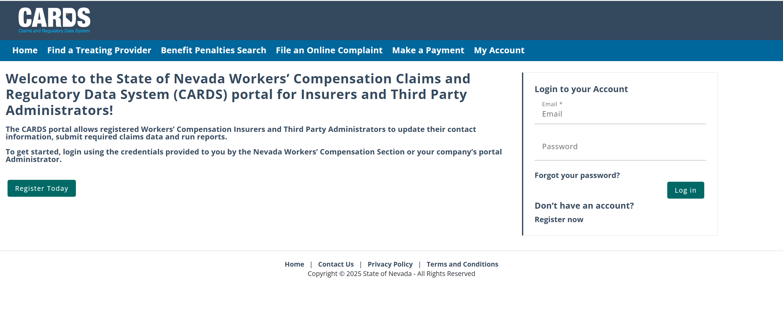
COMPLAINT WEBFORM
FILING A COMPLAINT IN CARDS FOR NON-AUTHENTICATED USERS
Notes:
You as an authenticated user do not want to access the complaint form here (this version does not allow you to upload supporting documents).
You will sign-in and select “Complaints” from your Forms and Tools button.

Slide 30
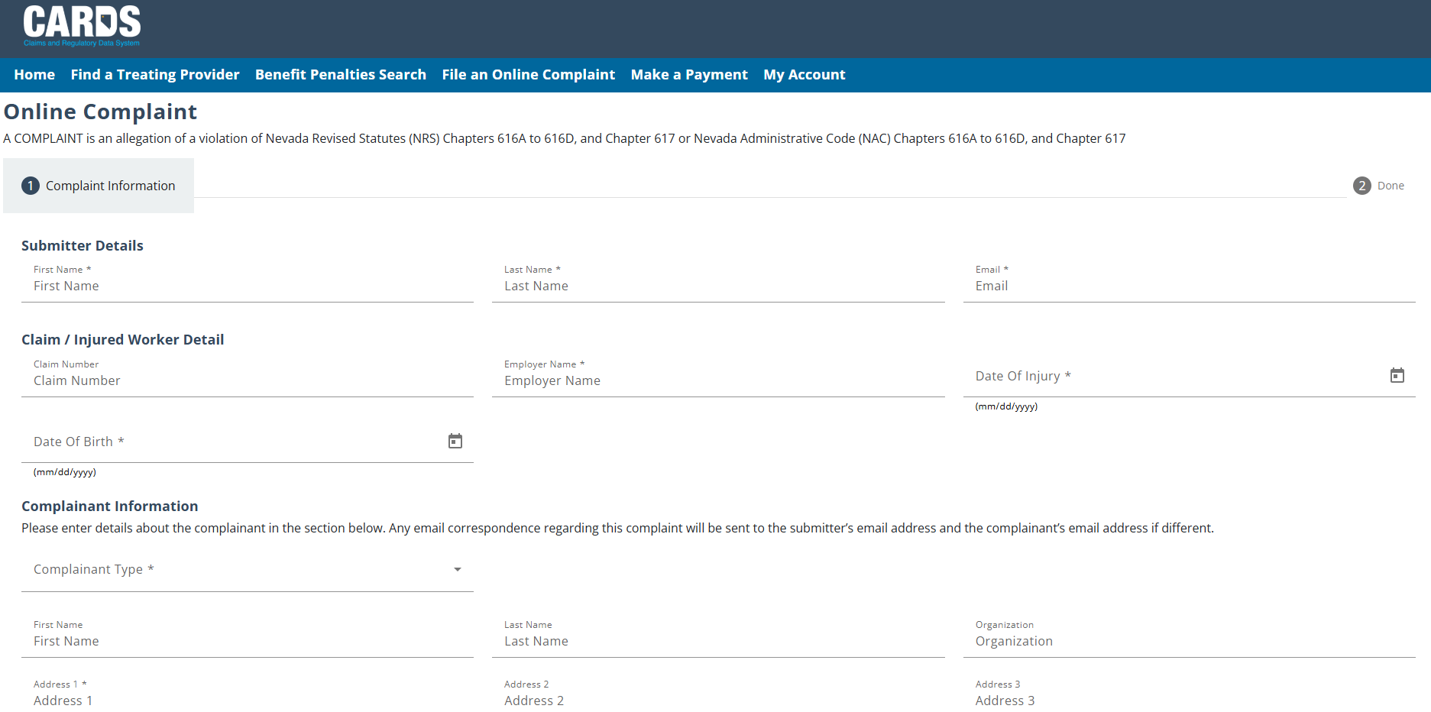
COMPLAINT WEBFORM
FILING A COMPLAINT IN CARDS FOR NON-AUTHENTICATED USERS

Slide 31
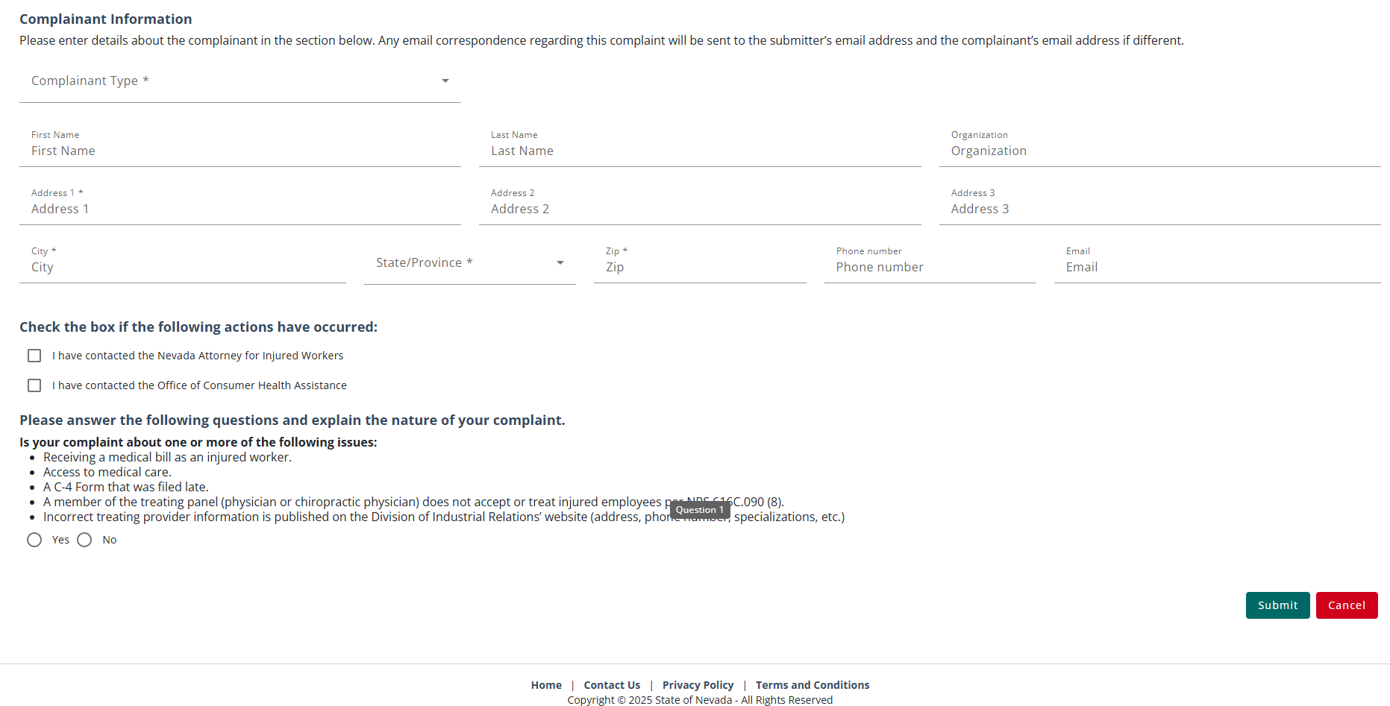
COMPLAINT WEBFORM
FILING A COMPLAINT IN CARDS FOR NON-AUTHENTICATED USERS
Provide all the necessary information then hit Submit.

Slide 32
WCS INVESTIGATION TIMELINE
NRS 616D.130 Investigation of alleged violation; determination of Administrator.
1. Upon receipt of a complaint for a violation of subsection 1, 2 or 3 of NRS 616D.120, or if the Administrator has reason to believe that such a violation has occurred, the Administrator shall:
(a) Promptly provide a copy of the complaint, or an explanation of the reason the Administrator believes that a violation has occurred to:
(1) The Commissioner; and
(2) The insurer, organization for managed care, health care provider, third-party administrator, employer or professional employer organization that allegedly committed the violation; and
(b) Cause to be conducted an investigation of the alleged violation.
2. The Administrator shall:
(a) Within 30 days after receipt of a complaint pursuant to subsection 1, initiate an investigation;
(b) Within 60 days after the date on which the investigation is initiated, complete the investigation; and
(c) Within 30 days after the investigation is completed, render a determination and deliver a copy of the determination to:
(1) The Commissioner; and
(2) The insurer, organization for managed care, health care provider, third-party administrator, employer or professional employer organization that was the subject of the investigation.

Slide 33
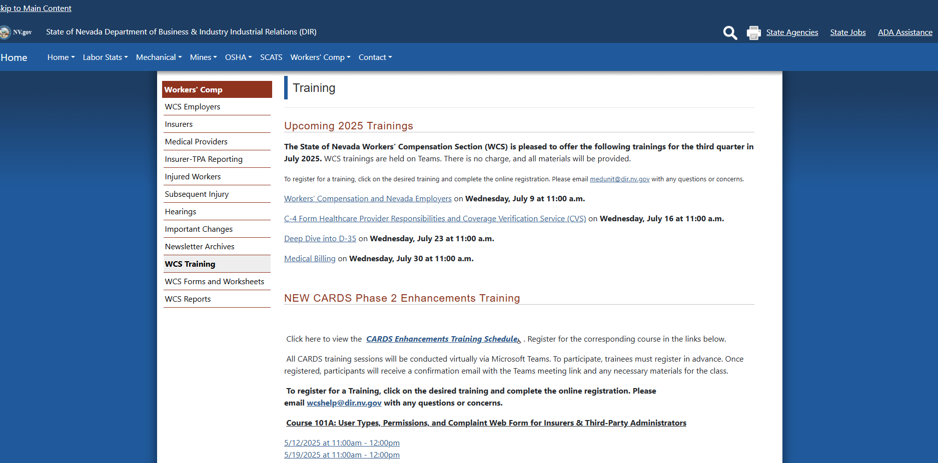
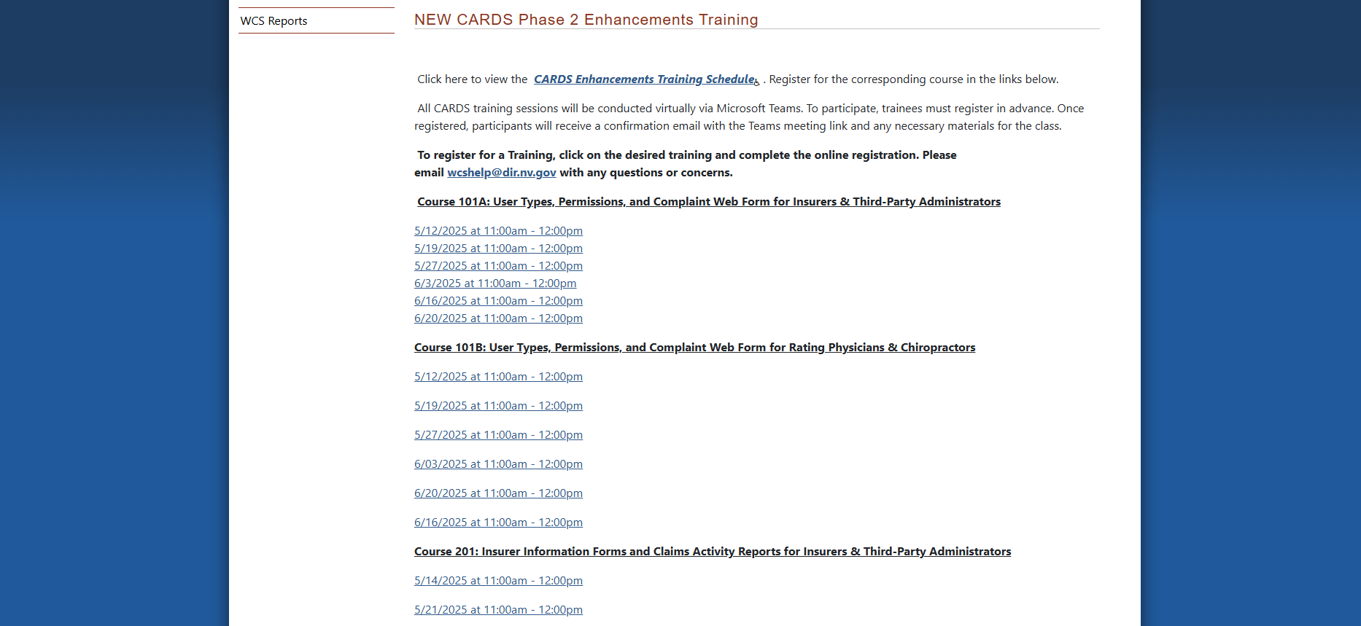
WHAT’S NEXT?

Slide 34
QUESTIONS?

Slide 35
THANK YOU

